Slide 1

Online Food Ordeing System Under E-commerce
SCHOOL OF ENGINEERING
DEPARTMENT OF COMPUTER SCIENCE & ENGINEERING
Batch – A17 Team Numbers:
B.Pavan-237Z1A0511
J.Charan-237Z1A0563 B.Nithil-237Z1A0525
Under the Guidance of
Mr.CH.Ravi
Assistant Profesor

Slide 2

CONTENTS
•
•
•
•
•
•
•
•
Abstract
Problem Statement Literature Survey
Limitations of Existing System Proposed System
Advantages
Software and Hardware Requirements Conclusion

Slide 3

Abstract
The rapid growth of internet and digital technologies has greatly transformed modern business practices, particularly in electronic commerce. This project focuses on the design and development of an Online Ordering System under an e-commerce website. The system allows users to register, browse products, add items to a shopping cart, and place orders through an online platform. It also supports secure order processing and online payment functionality. An administrative module is included to manage products, monitor customer orders, and update order status efficiently. The system reduces manual effort, minimizes errors, and improves operational efficiency through automation. Overall, the project provides a user-friendly and scalable solution suitable for small to medium-sized online businesses.

Slide 4

Problem Statement
Existing online ordering systems lack proper automation, leading to inefficiencies, delays, errors, poor customer experience, and limited real-time administrative control.

Slide 5
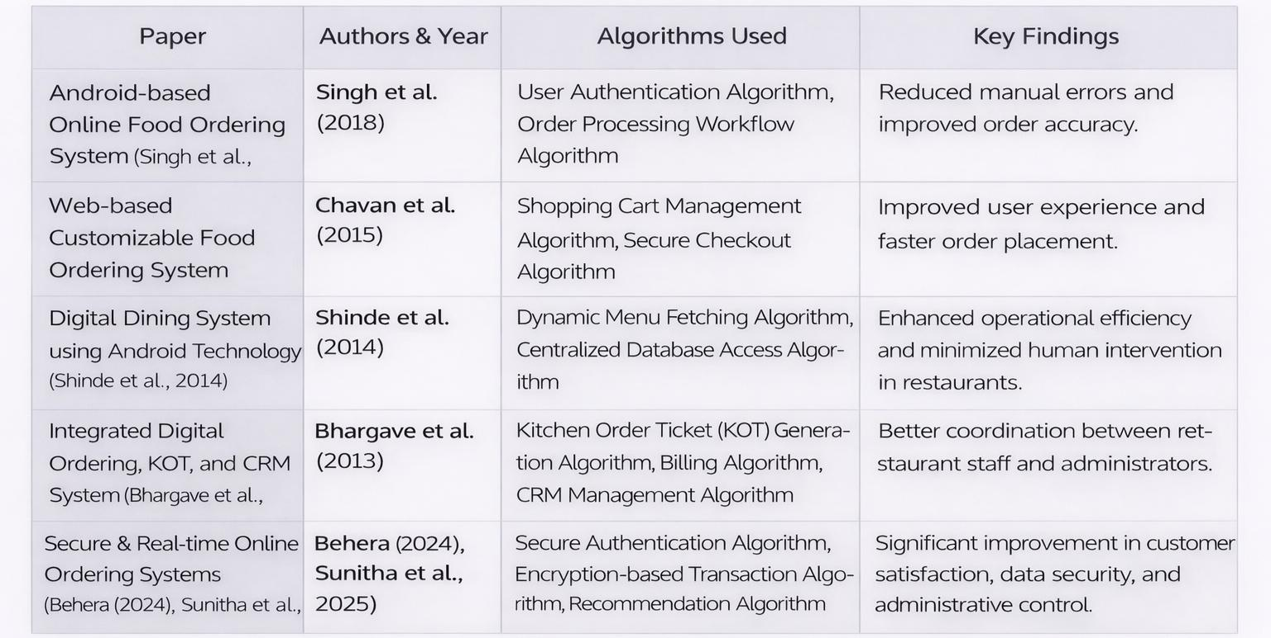
Literature Survey

Slide 6
Limitations of Existing system
Manual or phone-based order processing
Time-consuming and inefficient operations
Difficult menu and order management
High dependency on human intervention

Slide 7
Proposed System
Provide secure user registration and authentication for customers.
Enable product catalog display for easy browsing and selection of products.
Implement shopping cart functionality and order placement process.
Support secure order processing with online payment options.
Develop an administrative module for product management and order monitoring.
Provide real-time order status updates to improve efficiency and user experience.

Slide 8
Features of the System
Secure user authentication for controlled system access
Centralized database for storing user, order, and product information
Web-based ordering platform accessible through browsers
Automated order processing and record management
Admin-controlled product and order management system
Real-time update of order status in the system
User-friendly and responsive web interface

Slide 9
Extra Features
Smart Meal Planning System
Health & Nutrition-Based Ordering
Local Home-Chef Marketplace
Budget-Based Ordering

Slide 10
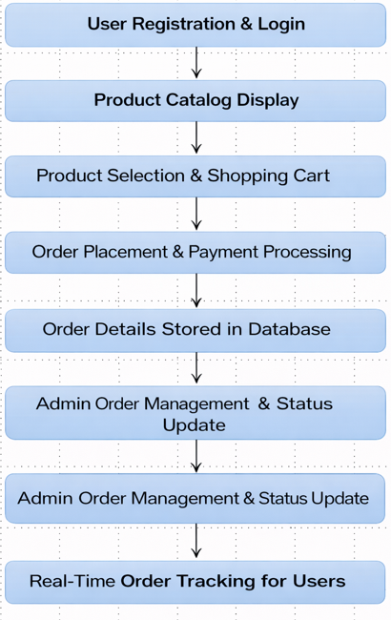
System Framework

Slide 11
Advantages
The system automates product browsing, order placement, and order processing, reducing manual work and human errors
Orders are processed faster compared to manual systems, improving operational speed and service efficiency.
Customers and administrators can track order status in real time, ensuring transparency and timely updates.
Admin can easily manage product details and stock levels through a centralized system, improving accuracy.
Secure login and payment mechanisms enhance data security and build customer trust.

Slide 12
Software and Hardware Requirements
Software Requirements:
Frontend Technologies:HTML, CSS, JavaScript
Backend Technology: Python (Django)
Database: MySQL
Web Server: Apache
Development Tools: VS Code
Browser: Google Chrome

Slide 13
Hardware Requirements
Processor: Intel Core i3 or higher
RAM: Minimum 4 GB
Hard Disk: 100 GB free space
System Type: 64-bit architecture
Internet Connection: Required
Input Devices: Keyboard, Mouse
Output Devices: Monitor

Slide 14
Conclusion
The Online Ordering System provides a user-friendly platform for browsing products, placing orders, and making secure online payments.
The system automates the ordering process, reducing manual effort, minimizing errors, and improving operational efficiency.
The admin module enables effective product and order management, making the system scalable for small to medium-sized businesses.

Slide 15


